Slide 1

Cost-of-Living Analysis
Presenter Yashaswi Gadde

Slide 2
Contents
Introduction
About the Dataset
Dashboard
Various Analysis
Summary
Presentation Title

Slide 3

Introduction
This project revolves around the analysis of the cost of living in various cities and countries across the globe. The dataset used for this analysis encompasses a wide range of economic indicators, from the price of basic commodities to the cost of housing, transportation, and even entertainment.

Slide 4


The dataset utilized in this project is sourced from Numbeo, a collaborative online database that provides cost of living information worldwide. It contains 56 columns, including information about cities, countries, and a wide array of cost-related variables, ranging from grocery prices to real estate costs. The dataset is designed to offer a comprehensive view of the economic aspects of various locations, making it a valuable resource for conducting cost-of-living analyses.
ABOUT THE DATASET

Slide 5
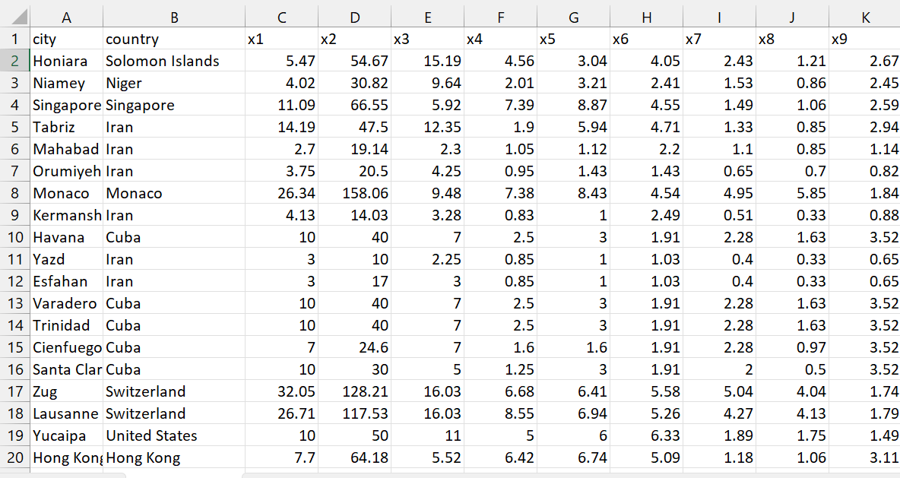

Slide 6
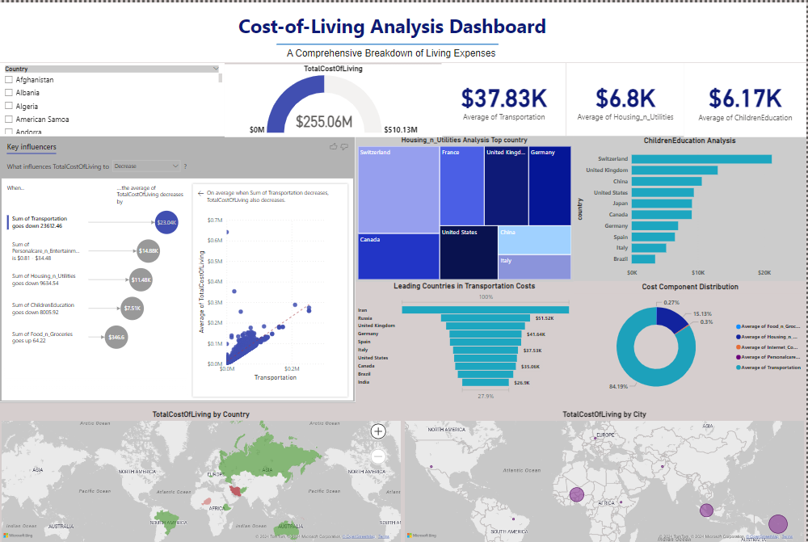
Snapshot of Cost-of-Living Dashboard

Slide 7
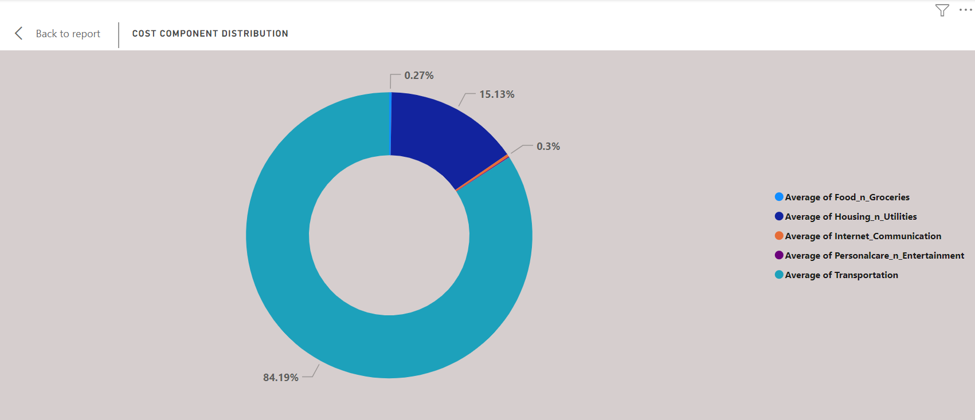
Cost Component Distribution
Transportation: The largest portion of the cost distribution is transportation, accounting for 84.19% of the total costs. This indicates that transportation is the primary expense in the overall cost of living.
Housing and Utilities: The second-largest component is housing and utilities, making up 15.13% of the total costs. Although significantly less than transportation, it is still a notable part of the cost distribution.
Internet and Communication: This category represents a very small fraction of the total costs at 0.3%.
Food and Groceries: Similarly, food and groceries constitute a minor part of the costs, at 0.27%.
The doughnut chart visually emphasizes the disproportionate contribution of transportation to the total cost of living, compared to the other components.

Slide 8
Key Takeaways:
Transportation Costs: The overwhelming majority of the cost distribution is due to transportation. This highlights the importance of transportation expenses in the overall cost of living and suggests that any efforts to reduce living costs should prioritize addressing transportation costs.
Housing and Utilities: While not as dominant as transportation, housing and utilities still represent a significant portion of living expenses. Managing these costs can also contribute to reducing the overall cost of living.
Minor Cost Components: The minimal contributions of internet and communication, food and groceries, and personal care and entertainment suggest these areas have limited impact on the total cost of living. Efforts to reduce costs in these areas may have a lesser effect on the overall expense.
Conclusion:
The "Cost Component Distribution" doughnut chart provides a clear visual representation of the disproportionate impact of transportation costs on the overall cost of living. It highlights transportation as the primary target for cost reduction strategies, with housing and utilities as secondary considerations. The other components, due to their minimal contributions, are less critical in efforts to manage living costs.

Slide 9
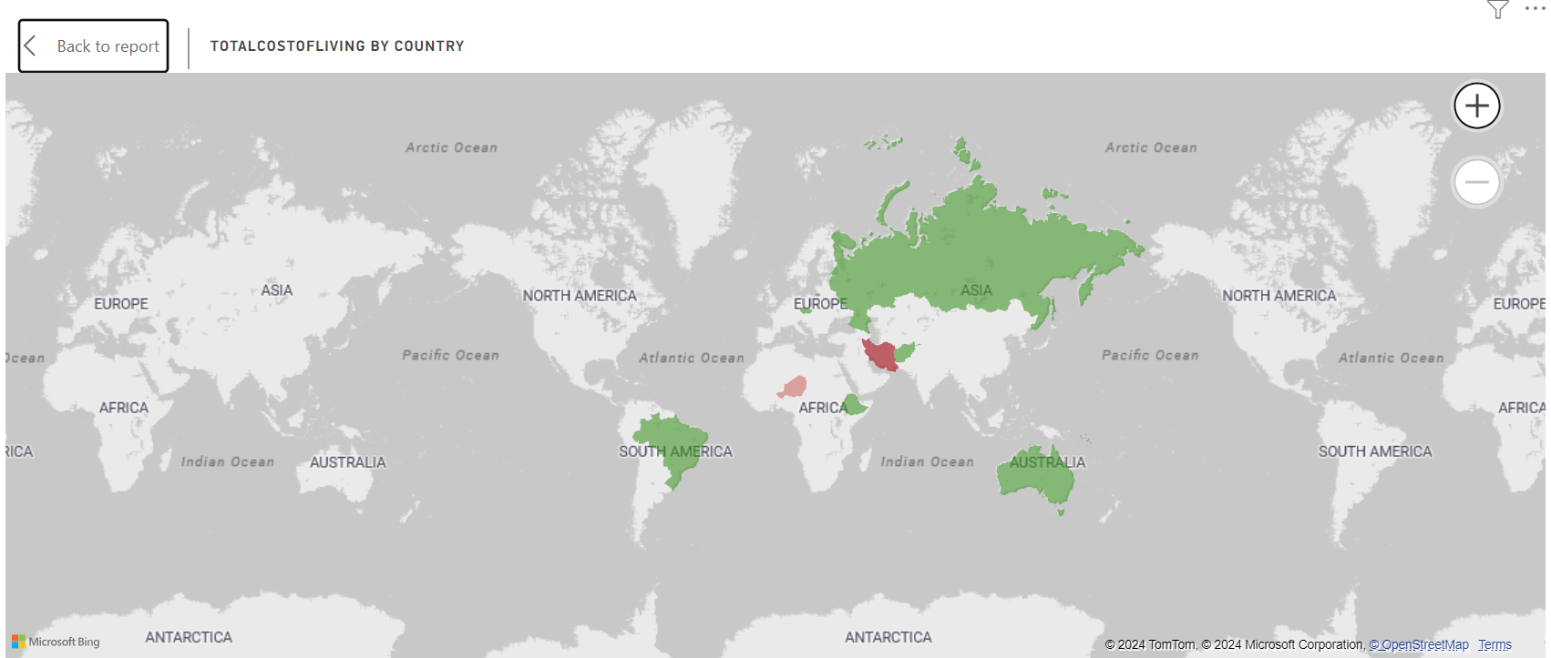
Total Cost-of-Living by Country

Slide 10
Insights from the "Total Cost of Living by Country" Map:
High Cost of Living (Red Areas):
Iran: The map indicates Iran as the country with the highest cost of living. This aligns with the earlier chart showing Iran having the highest transportation costs.
Low Cost of Living (Green Areas):
Russia: Russia is prominently highlighted in green, indicating a low cost of living.
Brazil: Similarly, Brazil is also green, suggesting it has a lower cost of living compared to many other regions.
Key Takeaways:
High-Cost Regions:
Iran stands out significantly as a high-cost region, suggesting that the overall living expenses there are substantially higher than in other countries highlighted.
Low-Cost Regions:
Countries like Russia, Brazil, and Australia are highlighted as low-cost regions, indicating more affordable living expenses.
Conclusion:
The "Total Cost of Living by Country" map provides a visual representation of the cost of living disparities across different regions. Iran is identified as having the highest cost of living, particularly influenced by its high transportation costs. In contrast, Russia, Brazil, and Australia are highlighted as more affordable regions. The map underscores the importance of considering geographical and regional differences when analyzing living costs globally.

Slide 11
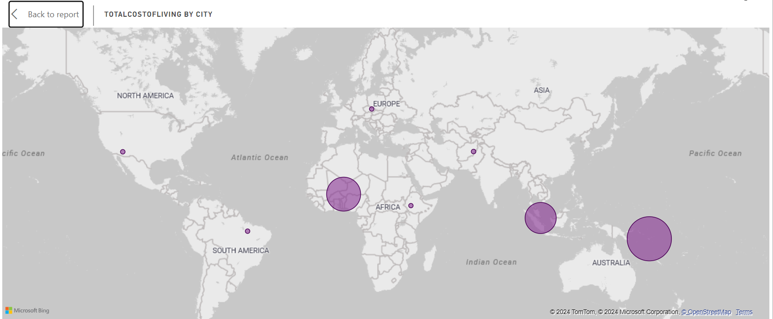
Total Cost-of-Living by City

Slide 12
High Cost of Living Cities:
Southeast Asia: There is a very large circle in Southeast Asia, indicating a city with a high cost of living. This is likely a major metropolitan area such as Singapore or Hong Kong, known for their high living expenses.
Australia/Oceania: A similarly large circle in the Oceania region suggests a city with a high cost of living, possibly Sydney or another major Australian city
Moderate Cost of Living Cities:
Europe: A smaller circle is seen in Europe, indicating a city with a moderate cost of living. This could represent a city with balanced expenses compared to high-cost cities in the region.
Asia: Another moderately sized circle is seen in Asia, suggesting a city with average living costs. This might be a second-tier city in countries with high variance in living costs
Low Cost of Living Cities:
South America: A relatively small circle in South America indicates a city with lower living costs, likely reflecting general affordability in the region.
Conclusion:
The map highlights significant geographical disparities in the cost of living across different cities globally. High-cost living areas are concentrated in major metropolitan regions in Southeast Asia, Oceania, and West Africa. Conversely, more affordable living costs are found in cities in South America, North America, and parts of Africa, reflecting the economic diversity and varying standards of living across the world.

Slide 13
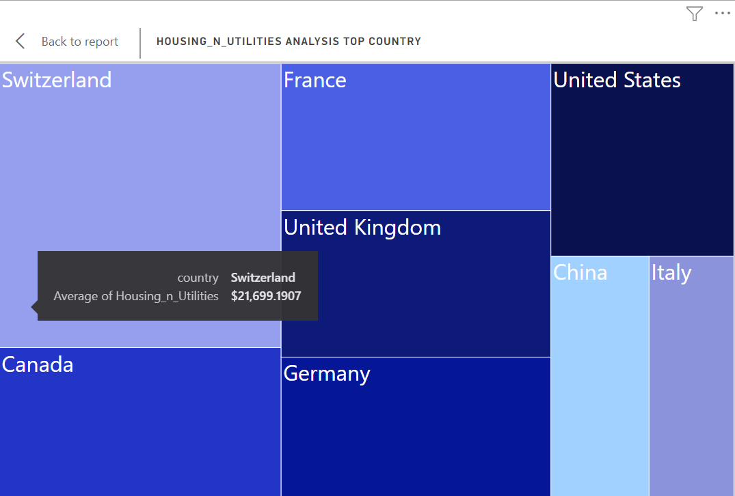
Treemap showing Housing and Utility Analysis
The purpose of this treemap is to visualize and compare the average costs of housing and utilities across various countries
Each rectangle in the treemap represents a country.
The size of each rectangle corresponds to the average cost of housing and utilities in that country.
Larger rectangles indicate higher average costs, while smaller rectangles indicate lower costs.
Highest Costs:
Switzerland has the highest average cost of housing and utilities, as indicated by its larger rectangle and tooltip information.
The treemap allows for a quick visual comparison of housing and utility costs between countries.
Other notable countries with high costs include France, the United States, and the United Kingdom, as they have relatively larger rectangles.
Conclusion:
The treemap effectively illustrates which countries have higher or lower average costs for housing and utilities, allowing for a straightforward comparison. Switzerland stands out as having the highest average cost among the displayed countries, making it easily identifiable due to the larger size of its rectangle.

Slide 14
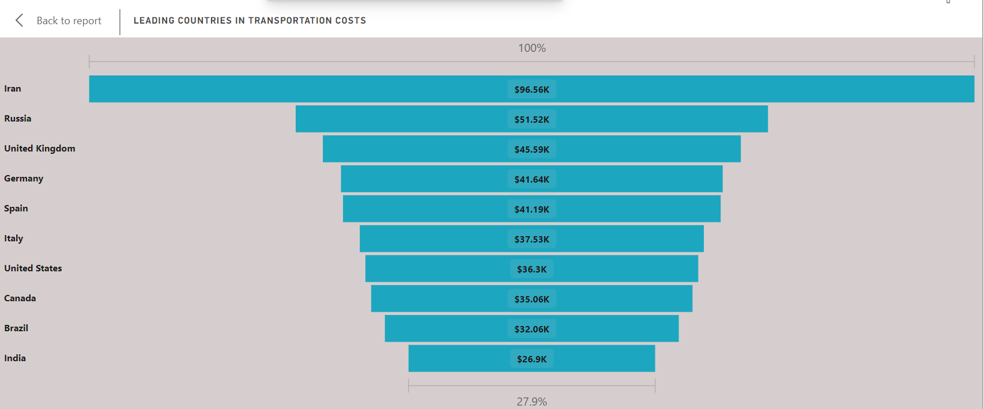
Transportation Cost Analysis
Iran has the highest transportation costs at $96.56K. This indicates that transportation in Iran is significantly more expensive compared to other countries listed.
United Kingdom ($45.59K), Germany ($41.64K), and Spain ($41.19K) also have high transportation costs, indicating a trend of high transportation expenses in some European countries.
The range of transportation costs spans from $26.9K in India to $96.56K in Iran. This wide range suggests a significant variation in transportation costs across different countries.
Conclusion:
This funnel chart effectively visualizes the top 10 countries with the highest transportation costs, highlighting Iran as the most expensive. The significant differences between the countries suggest diverse factors influencing transportation costs, such as fuel prices, infrastructure, and transportation policies.

Slide 15
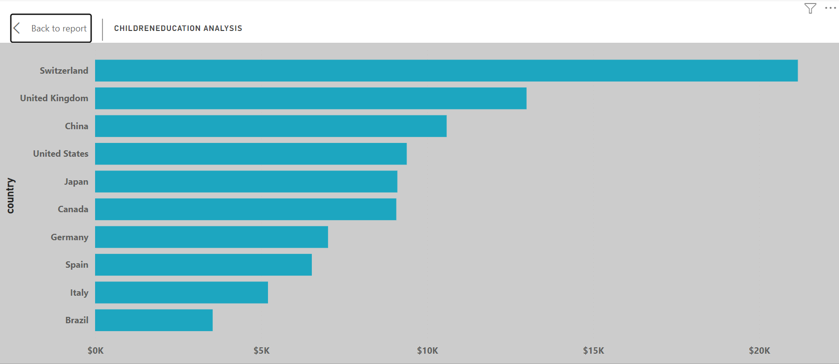
Children Education Analysis
This map represents the top 10 highest costs for children’s education analysis
The country with the highest costs is in Switzerland which represents the higher education costs in the country which affects the overall cost of living in the country
Then followed by the United Kingdom, China
Children’s education costs are almost negligible in the overall analysis when compared to transportation, housing, and food costs.
The no. of children in the family has a great effect on the overall education costs and hence the cost of living in a specific country

Slide 16
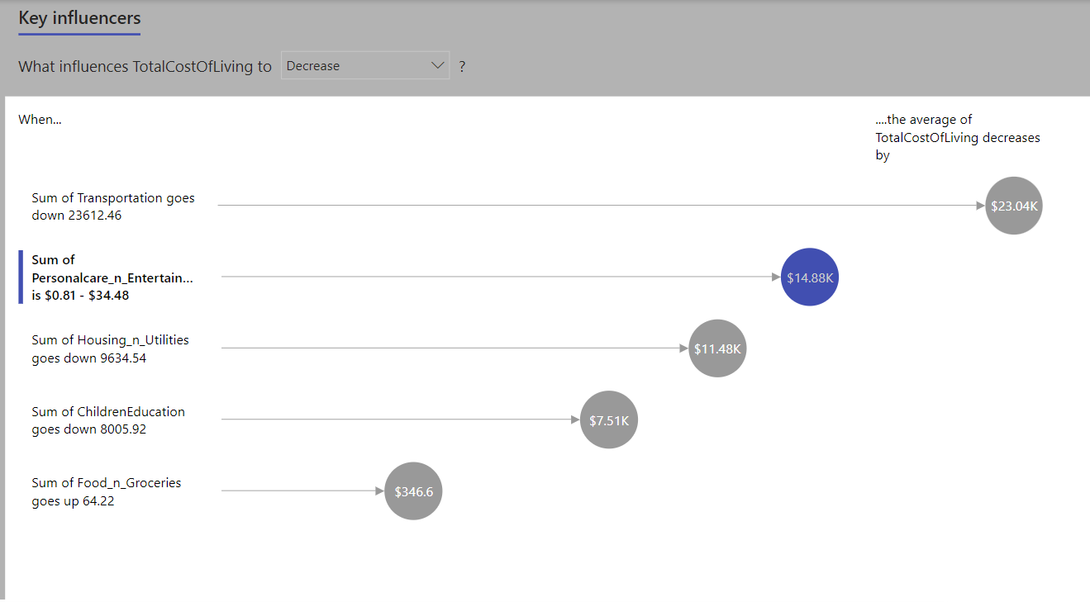
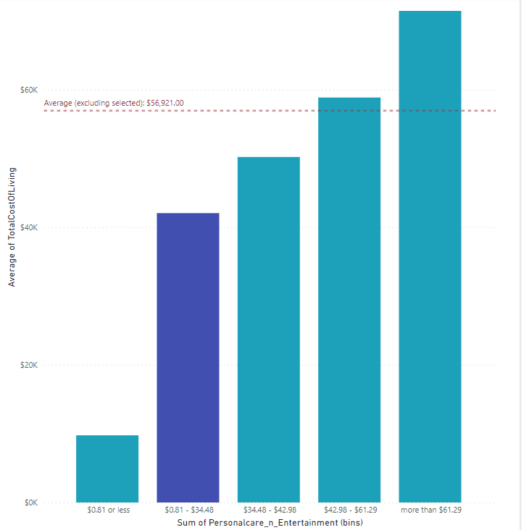
Key Influencers chart

Slide 17
Key Insights of the chart:
The Key Influencers chart in Power BI helps to identify the key factors that influence a particular metric—in this case, the Total Cost of Living. The chart highlights which variables have the most significant impact on decreasing the Total Cost of Living.
Components of the Chart:
Key Influencers List:
Title: "What influences TotalCostOfLiving to Decrease?"
Influencing Factors: The chart lists the factors in order of their impact on decreasing the Total Cost of Living. A visual indicator of its effect accompanies each factor.
Detailed Analysis for Selected Influencer:
Visualization: The bar chart shows how different ranges of the selected influencing factor affect the Total Cost of Living.

Slide 18
Key Influencers:
Sum of Transportation: When transportation costs decrease by $23,612.46, the average Total Cost of Living decreases by $23,040.
Sum of Personalcare_n_Entertainment: When costs in this category are between $0.81 and $34.48, the average Total Cost of Living decreases by $14,880.
Sum of Housing_n_Utilities: When housing and utility costs decrease by $9,634.54, the average Total Cost of Living decreases by $11,480.
Sum of ChildrenEducation: When education costs decrease by $8,005.92, the average Total Cost of Living decreases by $7,510.
Detailed Analysis
Selected Influencer: Sum of Personalcare_n_Entertainment
Insight: The bar chart indicates how different spending ranges on Personalcare_n_Entertainment correlate with the Total Cost of Living.
Bars: The height of each bar represents the average Total Cost of Living for different ranges of spending on Personalcare_n_Entertainment.
Ranges:
$0.81 or less: The average Total Cost of Living is significantly lower.
$0.81 - $34.48: The selected range, where the Total Cost of Living is notably decreased (highlighted in blue).
$34.48 - $42.98: The average Total Cost of Living is moderately high.
$42.98 - $61.29: The Total Cost of Living is higher.
More than $61.29: The highest average Total Cost of Living.
Average Line: An orange dotted line indicates the overall average Total Cost of Living ($56,921) excluding the selected influencer.

Slide 19
Interpretation:
Personalcare_n_Entertainment Influence: The key insight here is that lower expenditures in Personalcare_n_Entertainment (specifically between $0.81 and $34.48) are associated with a significant decrease in the Total Cost of Living.
Comparison: The chart allows you to compare the impact of different ranges of spending in the Personalcare_n_Entertainment category against the overall average Total Cost of Living.

Slide 20


Summary
Transportation is a Major Expense: The overwhelming dominance of transportation costs suggests a need for efficient and affordable transport solutions to reduce overall living expenses.
Geographical Disparities: There are significant variations in the cost of living across different regions and countries. Countries and cities with lower costs of living may provide more affordable options for those looking to manage their expenses.
Metropolitan Areas: High-cost living is concentrated in major urban centers, particularly in Southeast Asia, Oceania, and West Africa, highlighting the economic challenges and high demand in these cities.
Balanced Living Costs: Moderate-cost cities in Europe and Asia may offer a balanced lifestyle with reasonable living expenses, making them attractive for individuals seeking both quality and affordability.

Slide 21




Thank you

